Slide 1
MS&E 273
Technology Venture Formation
Reality Marketing For The Startup
Sue Barsamian / Audrey MacLean

Slide 2
Agenda
What is a marketing plan?
Where do startups go wrong?
Reality Marketing – The 4 things that really matter!

Slide 3
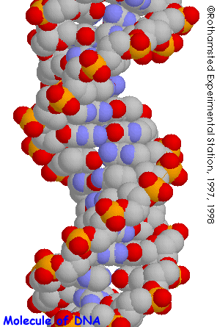
The Marketing Plan is…
the DNA
of your company

Slide 4
The Balance
You don’t yet know what you don’t know
The clock is ticking…
Time-to-market
Completeness
_{The}
_{Right}
_{Balance}
Risks
Foregone conclusions
Kool-aid reality
Risks
Analysis paralysis
Petri-dish reality

Slide 5
The Classic Marketing Plan
12 Step – Templates Downloadable On the Web
1
2
3
4
5
6
7
8
9
10
11
Mission
Situation
Analysis
(Trends)
Market
Pain
Our
Solution
Market
Ecosystem
Target
Market
Whole
Product
Offering
Distribution
Pricing
Competition
Positioning
Revenue
Model
Solution
Value
Addressable
Market
Operating
Plan
Go-to-Market
Objectives
12
Go-to-
Market Plan
and Budget
R&D
Plan
Sales
& Channel
Plan
Others
12

Slide 6
Throw In Some Models For Sizzle
_{O}
Market
attractiveness
_{O}
_{O}
Four P’s
Directional policy matrix
_{O}
McKenna
Moore
Boston
matrix
Garage.com
Legacy
v. Disruptive
Ries and Trout
Marketing
Models
Davidow
Zyman
_{X}
MarketingPlanPro
_{X}
Porter
NoLo
Perceptual
map
Product life
cycle
Kotler
Levitt
Collins
Palo Alto Software
_{X}
Four C’s
_{X}
Cost
experience
curve
Gap
analysis
Porter
matrix
Ansoff
matrix

Slide 7
MS&E 273
Technology Venture Formation
4
There are
Things That Really Matter

Slide 8
Reality Marketing
Cliff Notes To A Winning Plan
Big
Opportunity
Defendable
Differentiated
Position
Winning
Go To Market
Plan
Sustainable
Value
1
2
3
4

Slide 9
Find The Big Opportunity
What’s the category?
Is there an opportunity?
Will it be big?
1

Slide 10
What’s The Category?
Expanded
Market
Existing
Market
Today’s
Category
A new solution to a broader problem
A better, faster, cheaper alternative for today’s category
New
Market
Existing
Market
A new invention for a new category
Niche
Market
A specialized solution for a niche category

Slide 11
Is There An Opportunity?
Is there customer pain?
Is the pain sufficient to result in a compelling reason to buy?
PAIN
REASON TO BUY

Slide 12
Is The Opportunity Big and Growing?
Are there enough customers with this profile to make a market?
Quantitative
Analysts
Yankee
IDC
Meta
Forrester
Giga
PAIN
REASON TO BUY
Reality Check
Is this a market that really matters?

Slide 13
Size Your Market
Build a tops down and bottoms-up model
Total Market
Analyst data
Proxy modeling
Total Addressable Market
Your Projected Share
Empirical
Qualitative research
Your revenue and unit forecast

Slide 14
Reality Check
Big Opportunity
Is there sufficient pain to generate a compelling reason to buy?
Are there enough customers that meet this profile to make a big and growing category?
1

Slide 15
Reality Check
Carve Out A Defendable, Differentiated Position
Be Different
Be Defendable
2

Slide 16
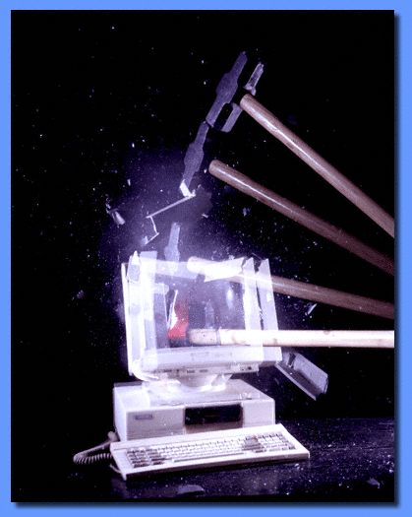
Be Different
Better, faster, cheaper is tough
Is there an existing context that needs to be smashed?

Slide 17

Be Defendable
Do Your Homework. Know The Competition
Yahoo
Portals
Potential
Legislation
AOL
Consumer
Protection/Privacy
Ecommerce
Intermediaries
eBay
Microsoft
Inktomi
Software
Platform/
Tools
Alta Vista
Overture
Search
Vendors
Paid
Listings

Slide 18
Get Your Positioning Right
Clear, Concise, Consistent
Market Definition
Executive Summary
For(target customer)
Who (statement of the need
or opportunity)
The (product name)
is a (product category)
Opportunity Need
Corporate
Presentation
Value/Compelling reason to buy
Elevator
Pitch
That (statement of key benefit
– the compelling reason to buy)
Unlike (primary competitive
advantage)
Our product (statement of
primary differentiation)
Competitive analysis
Web site,
collateral
Differentiated
position
Tagline

Slide 19
Reality Check
Carve Out A Defendable, Differentiated Position
Do you have a defendable, differentiation position?
Can you clearly articulate it?
Do your potential customers agree?
2

Slide 20
Build A Winning Go To Market Plan
Focused Target
Complete Offering
Effective Distribution and Value Chain
Winning Execution
3

Slide 21

Model The Value Chain
Max Price The Market Will Bear
Installation
Discounted Product Price
Reseller Margin
Net Revenue
Cost of Goods
What’s Really Left For Vendor

Slide 22
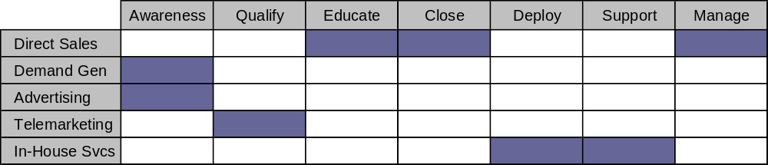
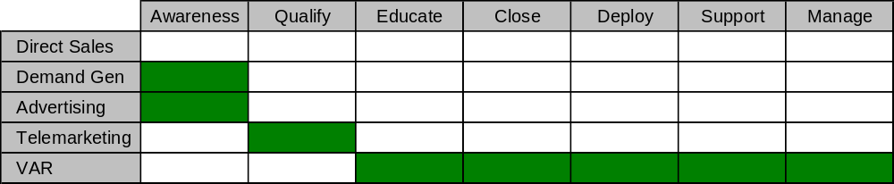
Think About Execution!
Map out the customer lifecycle
Direct Sales Model (100%)
Indirect Model

Slide 23
Reality Check
Winning Execution
Top segment identified?
  Understand buyer and influencer?
  Complete offering?
  Right price?
  Profitable channel?
  Winning go-to-market?
3

Slide 24
Show Sustainable Value
Can the business make money?
Where do you go next?
4

Slide 25
Profitability Model
Revenue
Gross Margin
Profit
Depreciation, Interest, Taxes
R&D
Finance/G&A
Sales
Support and Services
Marketing
Cost of Goods Sold
Licensed technology, product packaging,
operations costs, required services, etc.

Slide 26
Phase II Expansion
New Markets
New applications into existing segments
New segments
New geographies

Slide 27
Show Sustainable Value
Sustainable Value
Can this be a profitable, sustainable business?
What are your next expansion opportunities?
4

Slide 28
Reality Marketing
Cliff notes to a winning plan
Big
Opportunity
Defendable
Differentiated
Position
Winning
Go To Market
Plan
Sustainable
Value
1
2
3
4

Slide 29
MS&E 273
Technology Venture Formation
Good Luck!

Slide 30
TA Announcements
GATE I PRESENTATION
Saturday October 10th, from 8:30am – 12:30pm….be there early.
Meet at Terman 4th Floor Lobby
Presentations in Terman 453B and Dean’s Conference Room
Must watch the presentation of at least one other team
See website for GATE I details & sample presentations
MENTORS
Contact your mentors prior to GATE I and ask them to please review your slides
ASSIGNMENTS for 10/13:
Review Peter Kent’s Insight Financial Model. Have 2 questions per team for Peter during class.
OPPORTUNITY ASSESSMENT #2
(ONLY FOR TEAMS CHANGING THEIR CONCEPTS AFTER GATE I)
Due via email to the TAs by 8 PM October 17

